Slide 1
Blockchain
Manifest
Data
Go
Ideas
serverless
JavaScript
Cloud
Big
Data
output
variables
Mobile
Java
input
JVM
UX
security
build
Reactive
Issue
IA
OS
IOT
Process
Middleware
Innovation
Challenge
Deploy !
Pipeline
Web

Slide 2
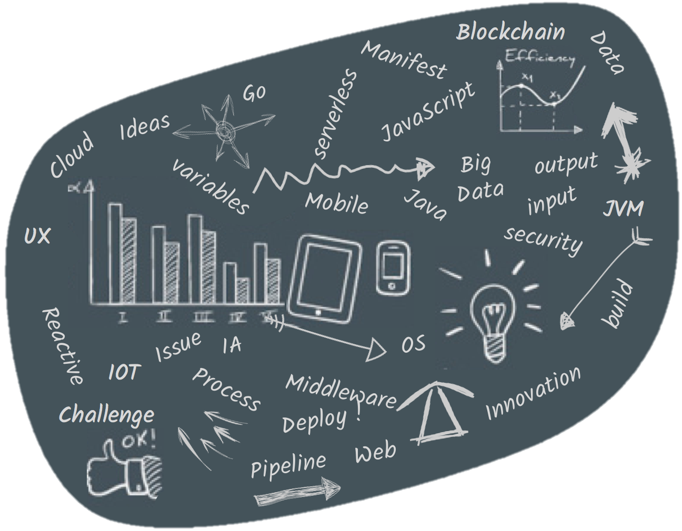

Slide 3


